Slide 1
Loops
Repeating Code Multiple Times

Slide 2
Table of content
What is a Loop?
Loops in C#
while loops
do … while loops
for loops
foreach loops
Special loop operators
break, continue, goto
Nested loops

Slide 3
What is a loop

Slide 4
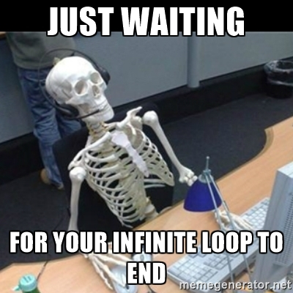
Loop definition
A loop is a control statement that repeats the execution of a block of statements
May execute a code block fixed number of times
May execute a code block while given condition holds
May execute a code block for each member of a collection
Loops that never end are called an infinite loops

Slide 5
While loop
Repeating a Statement While Certain Condition Holds

Slide 6
While loop
The simplest and most frequently used loop
The repeat condition
Returns a boolean result of true or false
Also called loop condition
while (condition)
{
statements;
}

Slide 7
How it works
condition
false
true
statement

Slide 8
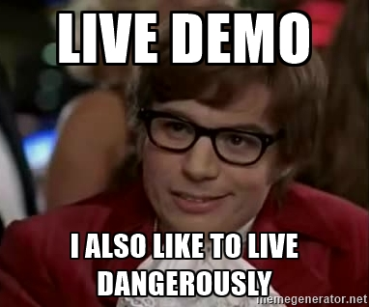
While loop live demo
Calculate and print the sum of the first N natural numbers

Slide 9

Do While loop

Slide 10
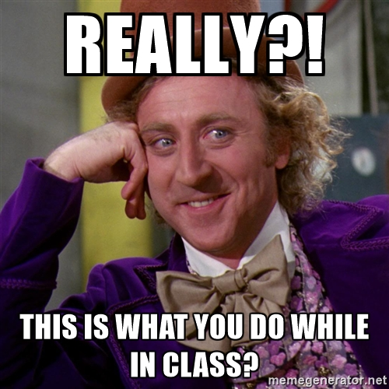
Do While loop
Another classical loop structure is:
The block of statements is repeated
While the boolean loop condition holds
The loop is executed at least once
do
{
statements;
}
while (condition);

Slide 11
How it works
statements
true
condition
false

Slide 12
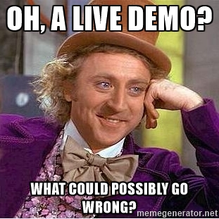
Do While live demo
Calculating N Factorial
Notes:
Show BigInteger (System.Numerics)

Slide 13
For loop

Slide 14
For loop
The typical for loop syntax is:
Consists of
Initialization statement
Boolean test expression
Update statement
Loop body block
for (initialization; test; update) { statements; }

Slide 15
Initialization expression
for (int number = 0; ...; ...) { // Can use number here } // Cannot use number here (out of scope)
The initialization expression
Executed once, just before the loop is entered
Like it is out of the loop, just before it
Typically used to declare a counter variable

Slide 16
Test expression
for (int number = 0; number < 10; ...) { // Can use number here } // Cannot use number here (out of scope)
The test expression is evaluated before each loop iteration
If true, the loop body is executed
If false, the loop finishes (and the loop body is skipped)
Used as a loop condition

Slide 17
Update expression
for (int number = 0; number < 10; number++) { // Can use number here } // Cannot use number here (out of scope)
The update expression
Executed at each iteration after the body of the loop is finished
Typically used to update the loop counter
Can update multiple variables

Slide 18
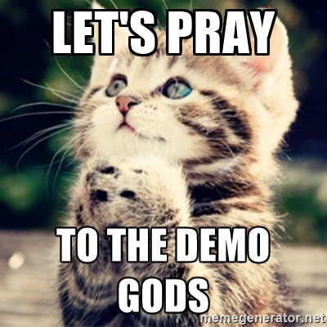
For loop live demo
Calculating n to power m (denoted as n^m)

Slide 19
Foreach loop
Iterating over a Collection

Slide 20
Foreach loop
The typical foreach loop syntax is:
Iterates over all the elements of a collection
The element is the loop variable that takes sequentially all collection values
The collection can be list, array or other group of elements of the same type
Inside a foreach loop we cannot modify the current item
foreach (var element in collection) { statements; }

Slide 21
Foreach live demo
Iterating over days of the week

Slide 22
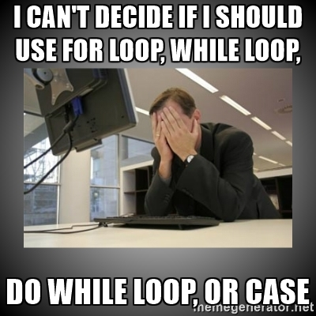
When to use
How to decide which construction to use

Slide 23
When to use
When to use While loop
Boolean condition
Statements can be skipped
When to use Do While loop
Boolean condition
Statements must be executed at least one time
When to use For loop
Iterating over indexed collections
Need to skip some indexes
Need to modify values
When to use Foreach loop
Iterating over non indexed collections
Iterating over indexed collection, but don’t want to change values

Slide 24
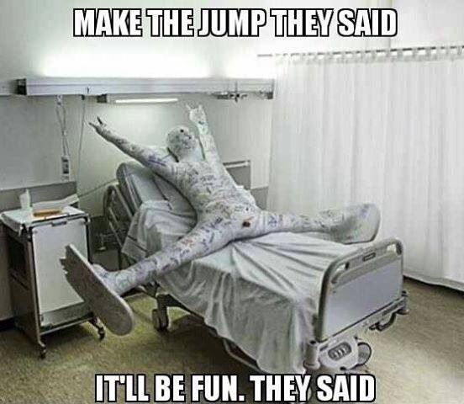
C# Jump statements

Slide 25
C# jump statements
Jump statements are:
break, continue, goto
How continue woks?
In while and do-while loops jumps to the test expression
In for loops jumps to the update expression
To exit the most-inner loop use break
To exit from an outer loop use goto with a label
Note: avoid using goto! (it is considered harmful)

Slide 26
C# jump statements
int outerCounter = 0;
for (int outer = 0; outer < 10; outer++)
{ for (int inner = 0; inner < 10; inner++)
{ if (inner % 3 == 0)
continue; if (outer == 7)
break; if (inner + outer > 9)
goto breakOut; }
outerCounter++;
} breakOut:
Label

Slide 27

Any questions

